Slide 1

Keyframe Animations

Slide 2
1. Introduction
Keyframe animation of an object is having a beginning state and will be changing over time. (This state can consist of a specific position, color, orientation, scale, or any other property of the object) till reaching the final state of the object. The purpose of the animation system is to use these discrete keyframes that is distributed over a period time to generate (interpolate) the intermediate states between each keyframe. This process is called inbetweening.

Slide 3
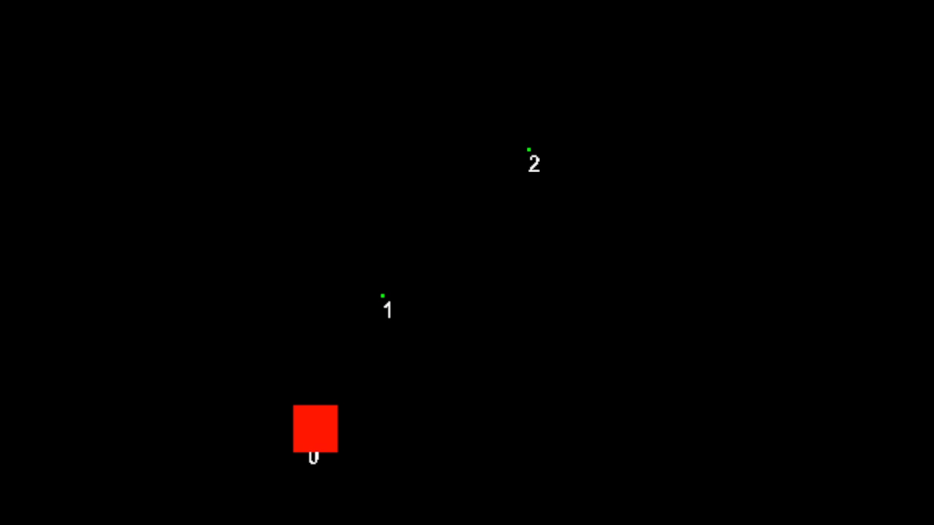
Basic keyframe Animation

Slide 4

Keyframe Animation System
1- Keyframe
The animation keyframe holds the state of a specific property of an object at a specific timestamp.
Keyframe property can be a float, multidimensional array, quaternion or Boolean value.

Slide 5


Keyframe Animation System
2- Animation Player
This is responsible for providing playback
Controls for an animations.
The Animation player should have the following functionalities:
1- Play, pause, stop, rewind, speed up/slow down, finish, play in reverse or loop the animation.
2- Add/remove Animatable objects.
3- Handles how the animation is being rendered.

Slide 6
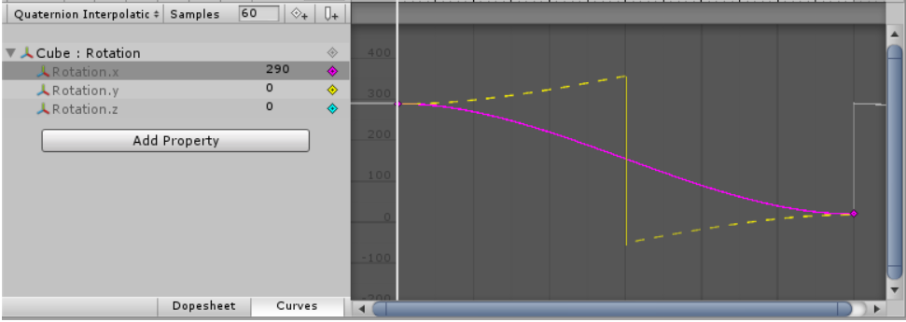
Keyframe Animation System
3- Timeline
The timeline holds all the changes of the object state over the time (keyframes). As well as interpolating the state of the object between these keyframes using different interpolation methods.

Slide 7
Keyframe Animation System
3- Timeline
The timeline holds all the keyframes for a singe (or multiple) properties of the object.
The timeline uses different interpolation methods depending on the property that is being interpolated.
These properties can be :
Position, color, scale, opacity, orientation, deformation, etc.…

Slide 8
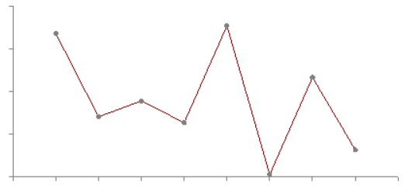
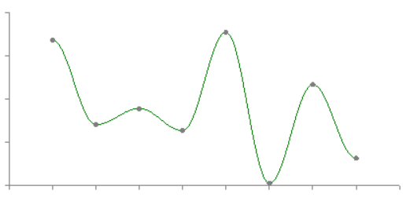

Interpolation Methods
1- Linear Interpolation
This type creates a uniform change between keyframes
2- Non-linear interpolation
This type creates a smooth non-uniform change between keyframes.
i.e.: Bezier, splines, easing interpolation
3- Hold or constant interpolation
This change of the next keyframe occurs suddenly and the transition stated are basically the state of the last keyframe.

Slide 9
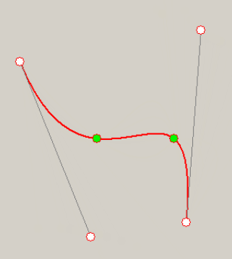
Interpolation Methods
Forced Bezier Curve
For any four points in series start, end points coincide with Bezier endpoints, and two internal points on curve can be used to define two control points of Bezier curve.
As mentioned here

Slide 10
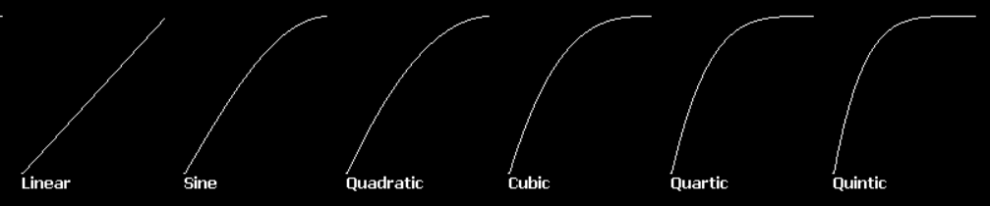
Interpolation Methods
Ease-in / Ease-out
Ease-In: The animation starts slowly.
Ease Out: The animation ends slowly.
Ease In Out: The animation starts slowly and ends slowly.
Different easing functions:
A way to approach this is to interpolate the time itself then use this interpolated time to interpolate the transitioning states.
This way easing methods can be combined with different other interpolation methods.

Slide 11
Interpolation Methods
Rotation interpolation
The to calculate the orientation from one state to another two interpolation methods can be used:
1- Euler Angles interpolation:
This method applies the full range of motion to the specified by the keyframe angles.
But this method have problem which is gimbal lock (when rotating around multiple axes at the same time). So, it’s preferred to use the second method.
2- Quaternion interpolation: rotates the object across the shortest distance to a particular orientation from a keyframe to another.

